Slide 1
Overview of my work 2006 - present
Rebeca Gonzalez Suarez

Slide 2


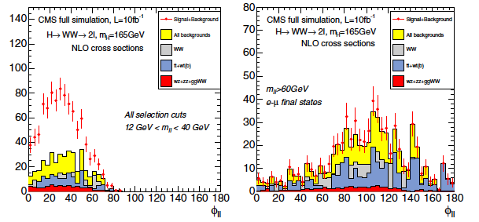
September 1st 2006
Start of “FPI” PhD grant with University of Oviedo-IFCA, joined CMS
Before that date:
Obtained Physics degree in June 2005 (Universidad de Oviedo)
Joined the HEP Oviedo group right after, contributing (unofficially) to the Physics TDR effort
The starting point of my PhD studies was the Higgs to WW section of the TDR
Right after the TDR was done, I took over the Higgs to WW with two muons and two neutrinos in the final state
The CMS Collaboration 2007 J. Phys. G: Nucl. Part. Phys. 34 995 doi:10.1088/0954-3899/34/6/S01

Slide 3
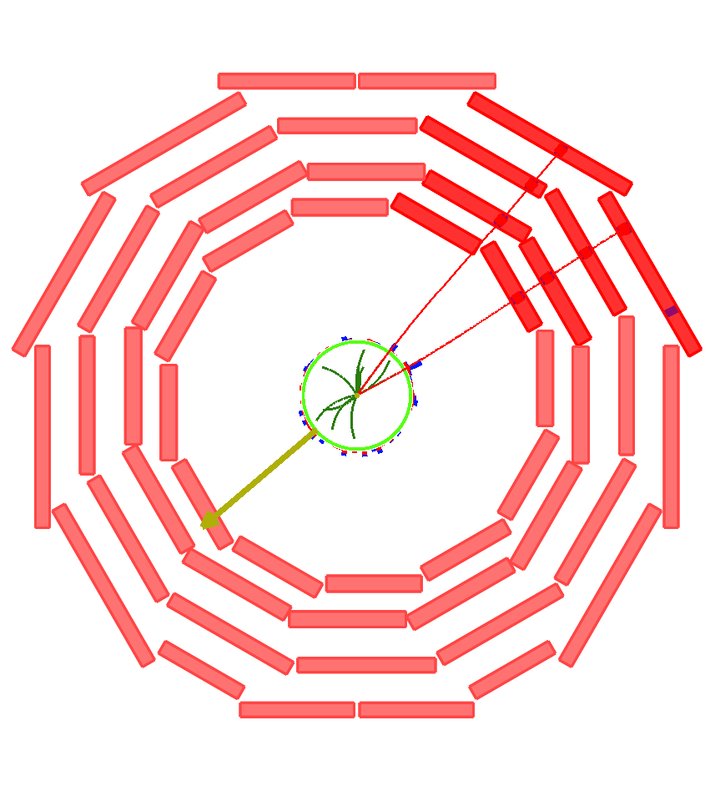
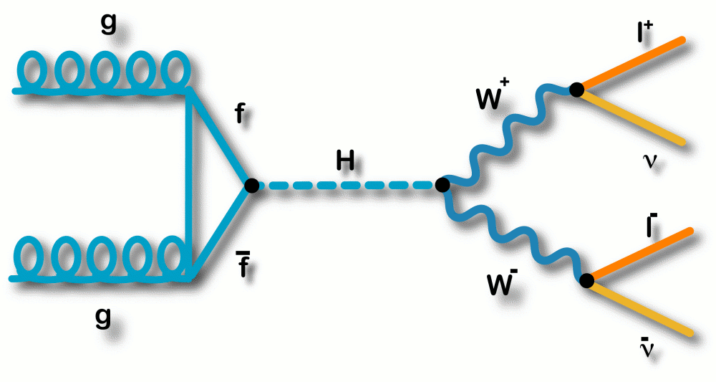
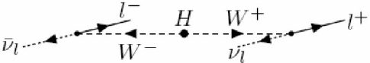
SM H → WW* → 2µ2ν
H → WW* → 2l2ν, discovery channel for a SM Higgs boson in a wide mass range in the LHC
Branching ratio close to 1 in 2m_{W} < m_{H} < 2m_{Z}
Clear experimental signature:
2 high P_{T} leptons with opposite charge and a small transverse opening angle (spin correlations)
Missing ET
No jets (gluon fusion)
Backgrounds:
Real or fake multi-lepton final states + missing ET:
‘irreducible’ WW (WZ, ZZ),
ttbar (tW),
Drell-yan, W+jets…

Slide 4
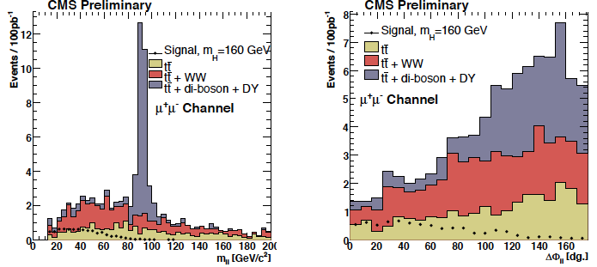
First contributions
14 TeV studies in Monte Carlo
Study of the variables
Mass-dependent optimization of the cuts:
low:(120, 130, 140) intermediate (150, 160, 170) and high (180, 190, 200)
First estimations of ttbar background (b-tagging)
PAS HIG-07-001
First Higgs PAS in which I participated
14 TeV, 100pb⁻¹
m_{H} = 160 GeV

Slide 5
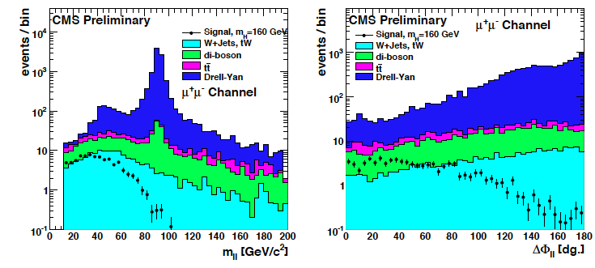
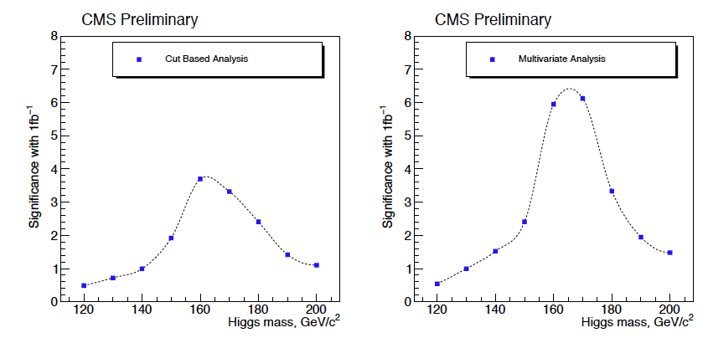
HIG-08-006
Next public analysis, before the start of the data-taking:
14 TeV, 1fb⁻¹
Mass dependent cuts, first multivariate analysis proposed
Control regions for WW and tt and first fake lepton studies
Prospective estimations of lepton and trigger efficiencies and systematic uncertainties
First significance estimations

Slide 6
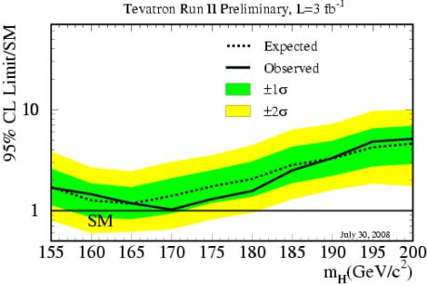
2008: Tevatron exclusion LHC incident
In ICHEP2008, around one month before the startup of the LHC, the Tevatron experiments announce the exclusion of SM Higgs with m_{H} ~170GeV, close to our (then) favorite mass, 160GeV
(This was the first plot of many that followed)
In September, the LHC starts operation, to be stopped 9 days later after an incident.
The LHC plans are altered in a big way, it means not only a large delay, but also a change in the running conditions.
The center of mass energy of the collisions will no more be 14TeV, but lower. Several scenarios are considered (initially 6 or 10 TeV)

Slide 7
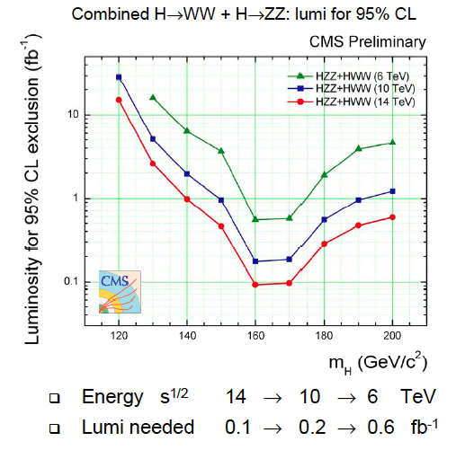
2009: Chamonix and 10 TeV
We react rapidly by preparing 14 to 10 and 6 TeV estimations, by scaling using the cross-section ratios and fast simulation
A reduced group of people working tirelessly during Christmas 2008/Early 2009 to produce public estimations for Chamonix 2009 (February)
The estimations presented were only Higgs WW/ZZ and the combination
10 TeV is the most likely scenario, Monte Carlo samples are prepared and the full analysis is carried out (never made public, CMS AN 2009/139)

Slide 8
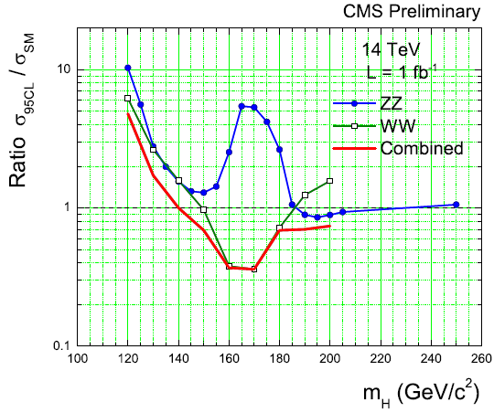
CMS projection for LHC@10TeV
Slide that I presented in PASCOS, July 2009
LHC 2009 - 2010 luminosity performance – estimate: ~200pb⁻¹ of “good data”
Strategy:
First understand detectors,
do SM measurements,
→ then search for the Higgs…
Is that possible in the early running?
CMS: 10 TeV projection using the combination of HWW and HZZ results @ 14 TeV
Signal and bkgd yields re-scaled 14→10 TeV: loss of a factor of 1.5 in sensitivity, or a factor of ~2 in luminosity
With roughly ~200 pb⁻¹, reach sensitivity for a SM Higgs with m_{H}~160-170 GeV/c² (comparable to the current Tevatron sensitivity)
☹ region just excluded by Tevatron!!!
CMS AN-2009/020
Notes:
r~0.4 at 1 fb-1 and 10 TeV implies that one should expect r~1 at L~(0.4/1)2~0.2 fb-1. The exclusion scales aproximately as r~1/sqrt(L).

Slide 9
2010: data @ 7 TeV
November 2009: Beams circulating again
January 2010: Chamonix, decision to run at 7 TeV (bye, bye 10 TeV studies)
February 2010: First theoretical estimations of cross-section and branching ratios for all the SM Higgs channels at 7 TeV
Fabian Stöckli and Rebeca Gonzalez Suarez, for the CMS Higgs Working-Group, “SM Higgs Production Cross-Section and Branching-Ratios at 10 TeV and 7 TeV” http://wwweth.cern.ch/HiggsCrossSections/ (obsolete)
March 2010: Collisions at 7 TeV
May 2010: Estimations of the Higgs potential at 7 TeV (from scaled 14 TeV results) made public (we also prepared estimations at 8 TeV!, plots are public)
7 TeV Monte Carlo ready, full analysis ready to perform (nothing public)

Slide 10
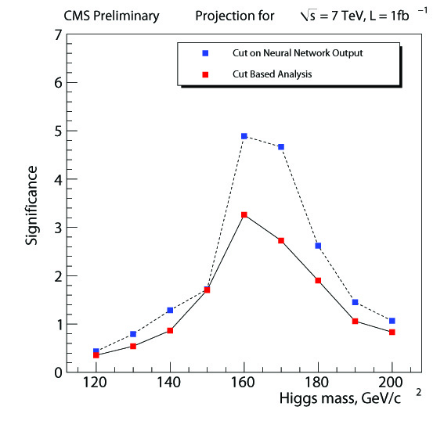
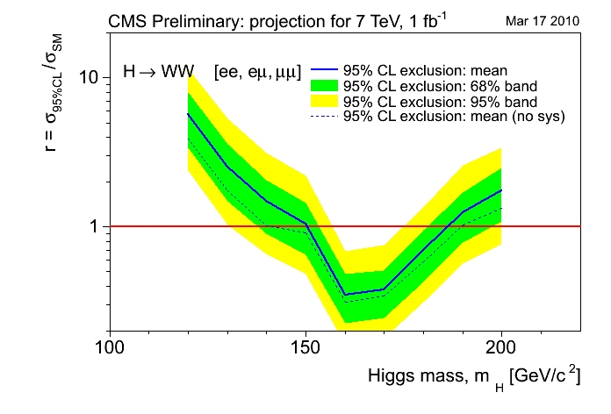
HWW projections @ 7TeV
CMS AN 2010/008 - 'The CMS physics reach for searches at 7 TeV'
(CMS Collaboration) http://cdsweb.cern.ch/record/1264099/
7 TeV, ∫Ldt = 1fb⁻¹ (projection)
Exclusion 95%CL: 150<m_{H}<185 GeV
Discovery level sensitivity (~5σ) : 160<m_{H}<170 GeV

Slide 11
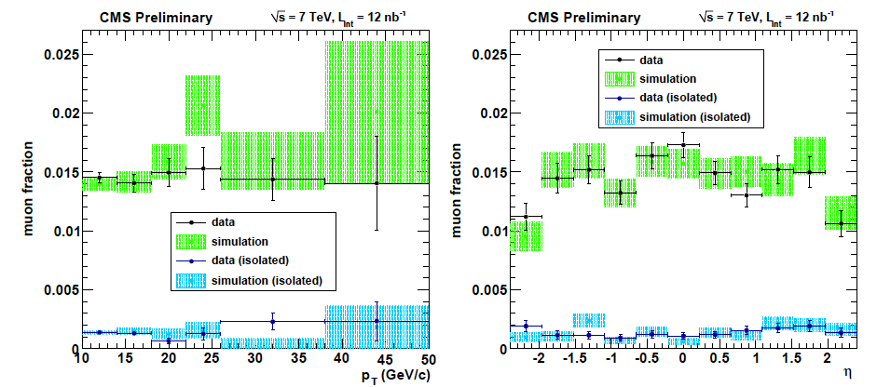
Work with early data (ICHEP 2010)
Study of tracks faking muons with 12nb⁻¹ (a part of the lepton fake rates studies made for Higgs to WW), appearing in the first muon public results with proton-proton collision data of CMS (MUO-10-002), presented in ICHEP 2010 (summer)

Slide 12
In parallel during my PhD
Service work: Software alignment of the DT chambers
“A Software and Computing prototype for CMS Muon System alignment”, (Iban Cabrillo, Isidro Gonzalez Caballero, Rebeca Gonzalez Suarez...), Journal of Physics: Conference Series 119 (2008) 072008
Higgs to WW BDT analysis: Gave the starting code for the implementation of BDT analysis in the HWW to 2µ2ν channel. Starting from the same pre-selection, I contributed sharing and updating code.
Helped in the analysis to measure the W charge asymmetry (CMS AN-2008/074) and slightly in the tt dilepton (CMS AN2010/406)
WW cross-section measurement: set-up the starting analysis and proposed within my group to measure it together with HWW (CMS AN-2009/025, CMS AN-2009/185)

Slide 13
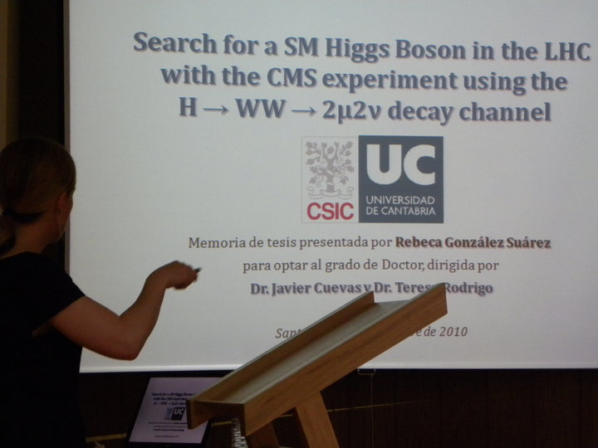
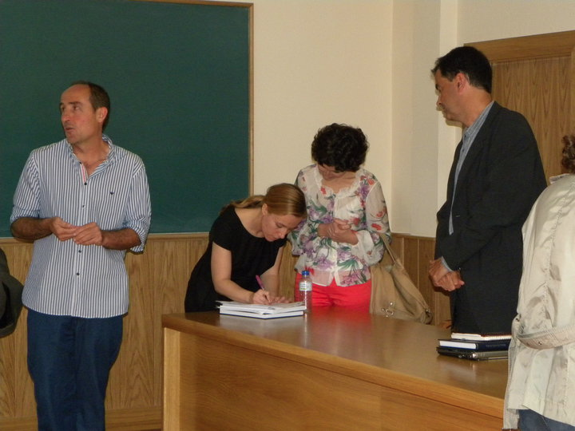
9 September 2010
Defense of PhD thesis:
“Search for a SM Higgs Boson in the LHC with the CMS experiment using the H → WW∗ → 2μ2ν decay channel”
http://cdsweb.cern.ch/record/1296019/
Dir. Javier Cuevas (Universidad de Oviedo) and Teresa Rodrigo (IFCA)
Sobresaliente Cum Laude

Slide 14

November 1st: Joined the VUB
In November 2010 I joined the Vrije Universiteit Brussel (VUB) as a postdoc, in the group of Jorgen D’Hondt with Freya Blekman as supervisor
I moved to top physics, in which the group has an important presence, starting by contributing to the e+jets cross-section analysis:
”Measurement of the tt Production Cross Section in pp Collisions at 7 TeV in Lepton + Jets Events Using b-quark Jet Identication”, CMS Collaboration (Serguei Chatrchyan et al.), Phys.Rev. D84 (2011) 092004, arXiv:1108.3773
Following that, I started my own analysis, studying the single top tW associated production:
Nobody was working on it
Process still to be observed
Only one rough early study made by CMS for the TDR (2006)
ATLAS already had results with data and a team formed
Most important: Very similar to HWW

Slide 15
Single Top tW associated production
Slide presented in approval talk
First step towards the experimental study of the Single Top Associated tW in CMS:
Too difficult at the Tevatron, with no results from CDF and D0
At the LHC, ATLAS had already public results with 2010 and 2011 data (upper limits in the cross-section)
CMS’s latest analysis of the tW channel: part of the physics TDR (2006)
It has a very interesting signature:
important background to Higgs searches (HWW)
After the observation of the process, a lot of physics to do:
Measure EW properties of the top-quark:
V_{tb} CKM matrix element, Wtb vertex
Sensitive to BSM processes, can be used to constrain the SM rate assuming lepton universality, etc.

Slide 16
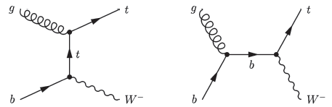
tW dilepton topology
tW leptonic final states (ee/eµ/µµ) studied
Sources of background:
ttbar (dominant background), Z+jets
EWK di-boson production (WW, WZ, ZZ)
W+jets, other single top processes (t and s channel) and QCD
Signal signature:
2 opposite sign, isolated leptons (e or µ)
Missing E_{T} (2 neutrinos)
1 jet (coming from a b-decay)
Similar signature
Higgs to WW + 1jet

Slide 17
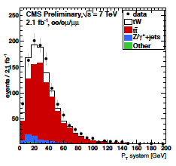
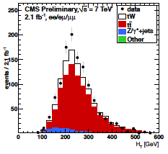
PAS TOP – 11 – 022
Working from scratch I prepared the analysis in Monte Carlo and applied it to 2011 data (2.1fb⁻¹ for the summer result, August 2011)
Simple cut-based approach applying a couple of extra kinematic cuts on events with two leptons, 1 b-tag jet and Missing E_{T}
After b-tagging only tt, a little Z+jets component, and tW signal remain
Z+jets estimated in/out Z mass window; tt background is more complicated and requires the use of two control regions (2jets 1b-tag, 2jets 2 b-tags)
CMS AN-2011/465

Slide 18
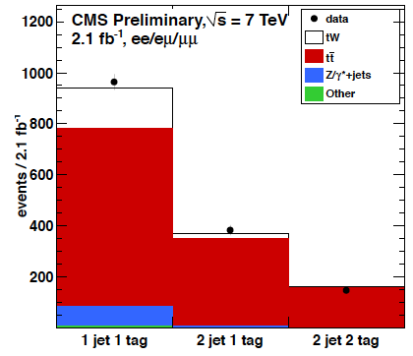
Summer result (2011)
Observed significance: 2.7σ
Expected significance: 1.8±0.9σ
Cross section value: 22+9-7 (stat+syst) pb
(PAS TOP-11-022, manpower and editor)
Working alone I got a better result than ATLAS with higher sensitivity (by then, ATLAS had 1.2σ)
Result obtained using 9 final states ( ee/eµ/µµ in signal and two tt control regions), multichannel statistical treatment (Higgs-like)
One of the highlights of TOP2011, the results appeared in many places after being made public (conferences, summary talks of CMS results, and the CERN courier –October 25-)

Slide 19
2012: tW paper
People joined the tW effort, I still work in the analysis but I’m also coordinating
~10 people at the moment, 2 new institutions, 2 PhD students to write their thesis about tW, +1 new student ready for 2012 data
Next goal in reach: PRL with CMS’s tW evidence (ATLAS just published the evidence just before ICHEP) using the full 2011 dataset
Multivariate analysis (based on a BDT) and cut-based as cross-check
To enter CWR very soon (next week hopefully!)
Internal CMS notes:
CMS AN-2011/465
CMS AN-2012/060
Coming soon!

Slide 20
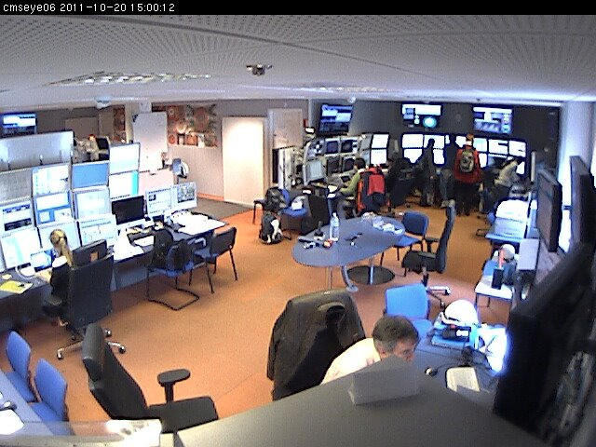
Service work and shifts
Contact person for the local reconstruction of the strips
Several developments of the code:
Automatic Peak-Deconvolution mode switch (before it was made “by hand”)
Removed possible occurrence of a mixed mode
Det Id information removal from the strip clusters
Reading information of FED errors from DQM files
…
Started doing shifts in 2008
I maintain a quota of > 20 points/year (this year for example, 31)
Different flavors:
DT offline (2008)
DT online (2008/2009)
DT on call (2009/2010)
Central DCS (2010/2011/2012)
Shift Leader (2012)

Slide 21
ARC activities
Member of different analysis review committees (ARC) since Summer 2011
SUSY analysis: multileptons + MET
SUS-11-019: “Search for Physics Beyond the Standard Model in Z + MET + Jets events at the LHC”
SUS-11-021: “Search for physics beyond the standard model in events with a Z boson, jets and missing transverse energy”
Search for physics beyond the standard model in events with a Z boson, jets, and missing transverse energy in pp collisions at sqrt(s)= 7 TeV, CMS Collaboration (Serguei Chatrchyan et al.), Submitted to Physics Letters B, arXiv:1204.3774
SUS-12-006 (Ongoing): EWKino paper “Search for electroweak production of charginos and neutralinos using leptonic final states in pp collisions at sqrt(s) = 7 TeV” (6 supporting notes)
SUS-12-007 (merged with SUS-12-006): WZ, ZZ + MET

Slide 22
Conferences
Poster about Muon alignment sent to CHEP07 (Victoria, Canada)
Presented a poster, ICHEP08 (Philadelphia, United States): "Discovery Potential for the SM Higgs Boson in the H to WW to 2l2 channel at LHC”
Talk on behalf of ATLAS and CMS, PASCOS 2009 (Hamburg, Germany): "EW symmetry breaking at the LHC”
Plenary talk on behalf of ATLAS and CMS, BEACH 2010 (Perugia, Italy): "Higgs Search Prospects at the LHC”
+ Chair of the session "Heavy Flavor Decays and Properties - I"
Invited Plenary talk, II CPAN days (Valencia, Spain): "Higgs and SUSY searches in CMS”
Chair of the poster session of the CMS Physics week in Brussels, 2011
Plenary Talk on behalf of ATLAS and CMS, Moriond 2012 (La Thuile, Italy): "Single Top Production at sqrt(s) = 7TeV”
Invited talk, 4th generation and single-top Workshop 2012 (Leinsweiler, Germany): "tW production at CMS”

Slide 23
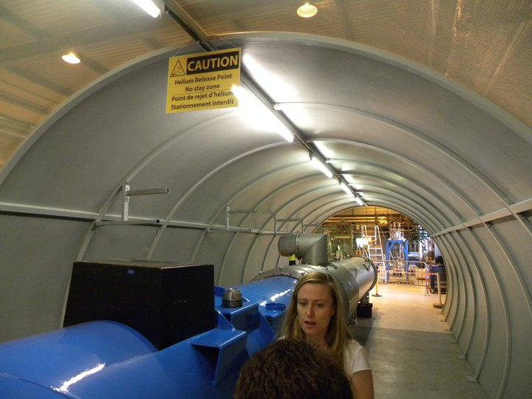
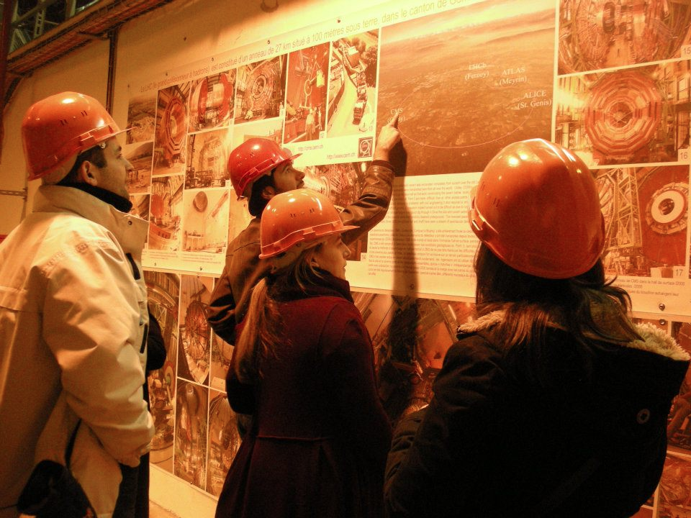
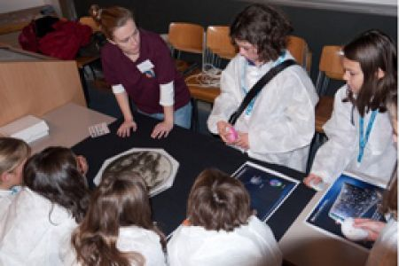
Outreach activities
CERN guide
CMS guide
Meet high school students for Q & A in March 2009 (Doña Jimena High school, Gijón, Spain)
Workshop leader of the "Questions without answers at the LHC" session in the Expanding your horizons (EYH) conference in Geneva, 12th November 2011 coordinating a group of 9 female LHC physicist receiving 3 groups of 45 girls (also from CMS in my session: Claudia Wulz, Bárbara Millán Mejías, María Cepeda) http://cms.web.cern.ch/news/cms-participates-expanding-your-horizons
…

